Slide 1






A Brief Introduction To Virtual Fence Technology
Andrew Antaya
Research Specialist
University of Arizona
School of Natural Resources and the Environment
Support From: Agriculture Genome to Phenome Initiative (AG2PI)
The findings and conclusions in this preliminary [publication/presentation/blog] have not been formally disseminated by the U. S. Department of Agriculture and Should not be construed to represent any agency determination or policy.
Additional Support from: Marley Endowment for Sustainable Rangeland Stewardship
The Arizona Experiment Station, University of Arizona
Western SARE
USDA-NIFA AFRI
Notes:
Mention the caveat that I don’t have all the answers today. We are actively working on this, We will be publishing factsheets on virtual fencing through Cooperative Extension in the next couple months.

Slide 2
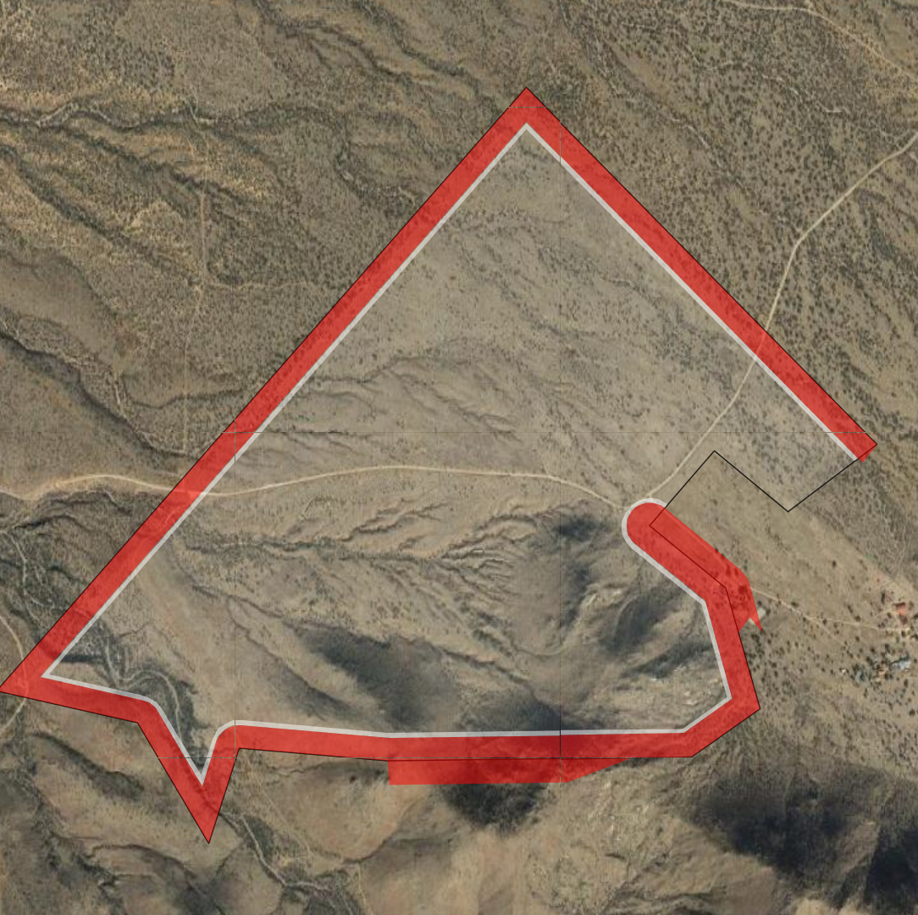
What are Virtual Fences?
Virtual Fence
Geographic boundary that is programmed into an electronic device, typically a collar worn by livestock
Notes:
Virtual fences are polygons whose boundaries are defined by geographic coordinates, similar to an ArcGIS shapefile.

Slide 3
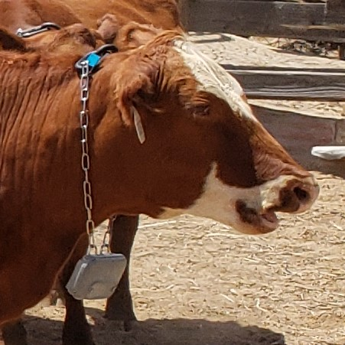
Virtual Fence Collars
GPS determines animal’s geographic location
Trains animals to stay within areas by sounds and electrical pulses
Transmits data to the Internet via radio or cellular network

Slide 4
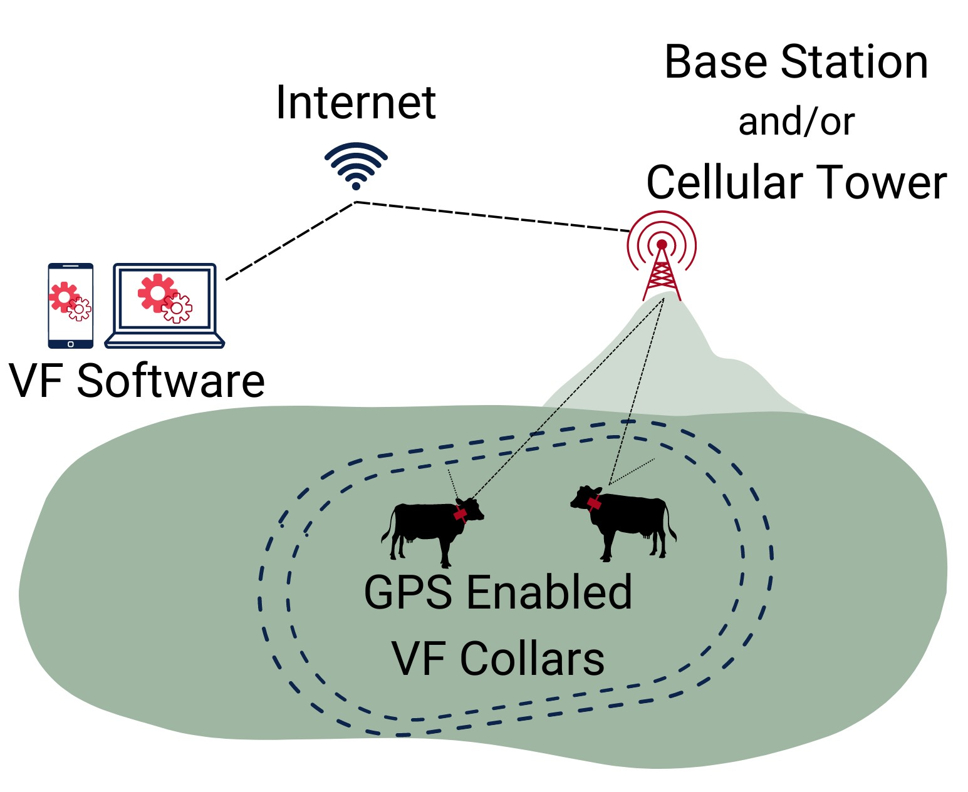
Notes:
This is just how the Vence brand of collars work. Other manufacturers

Slide 5
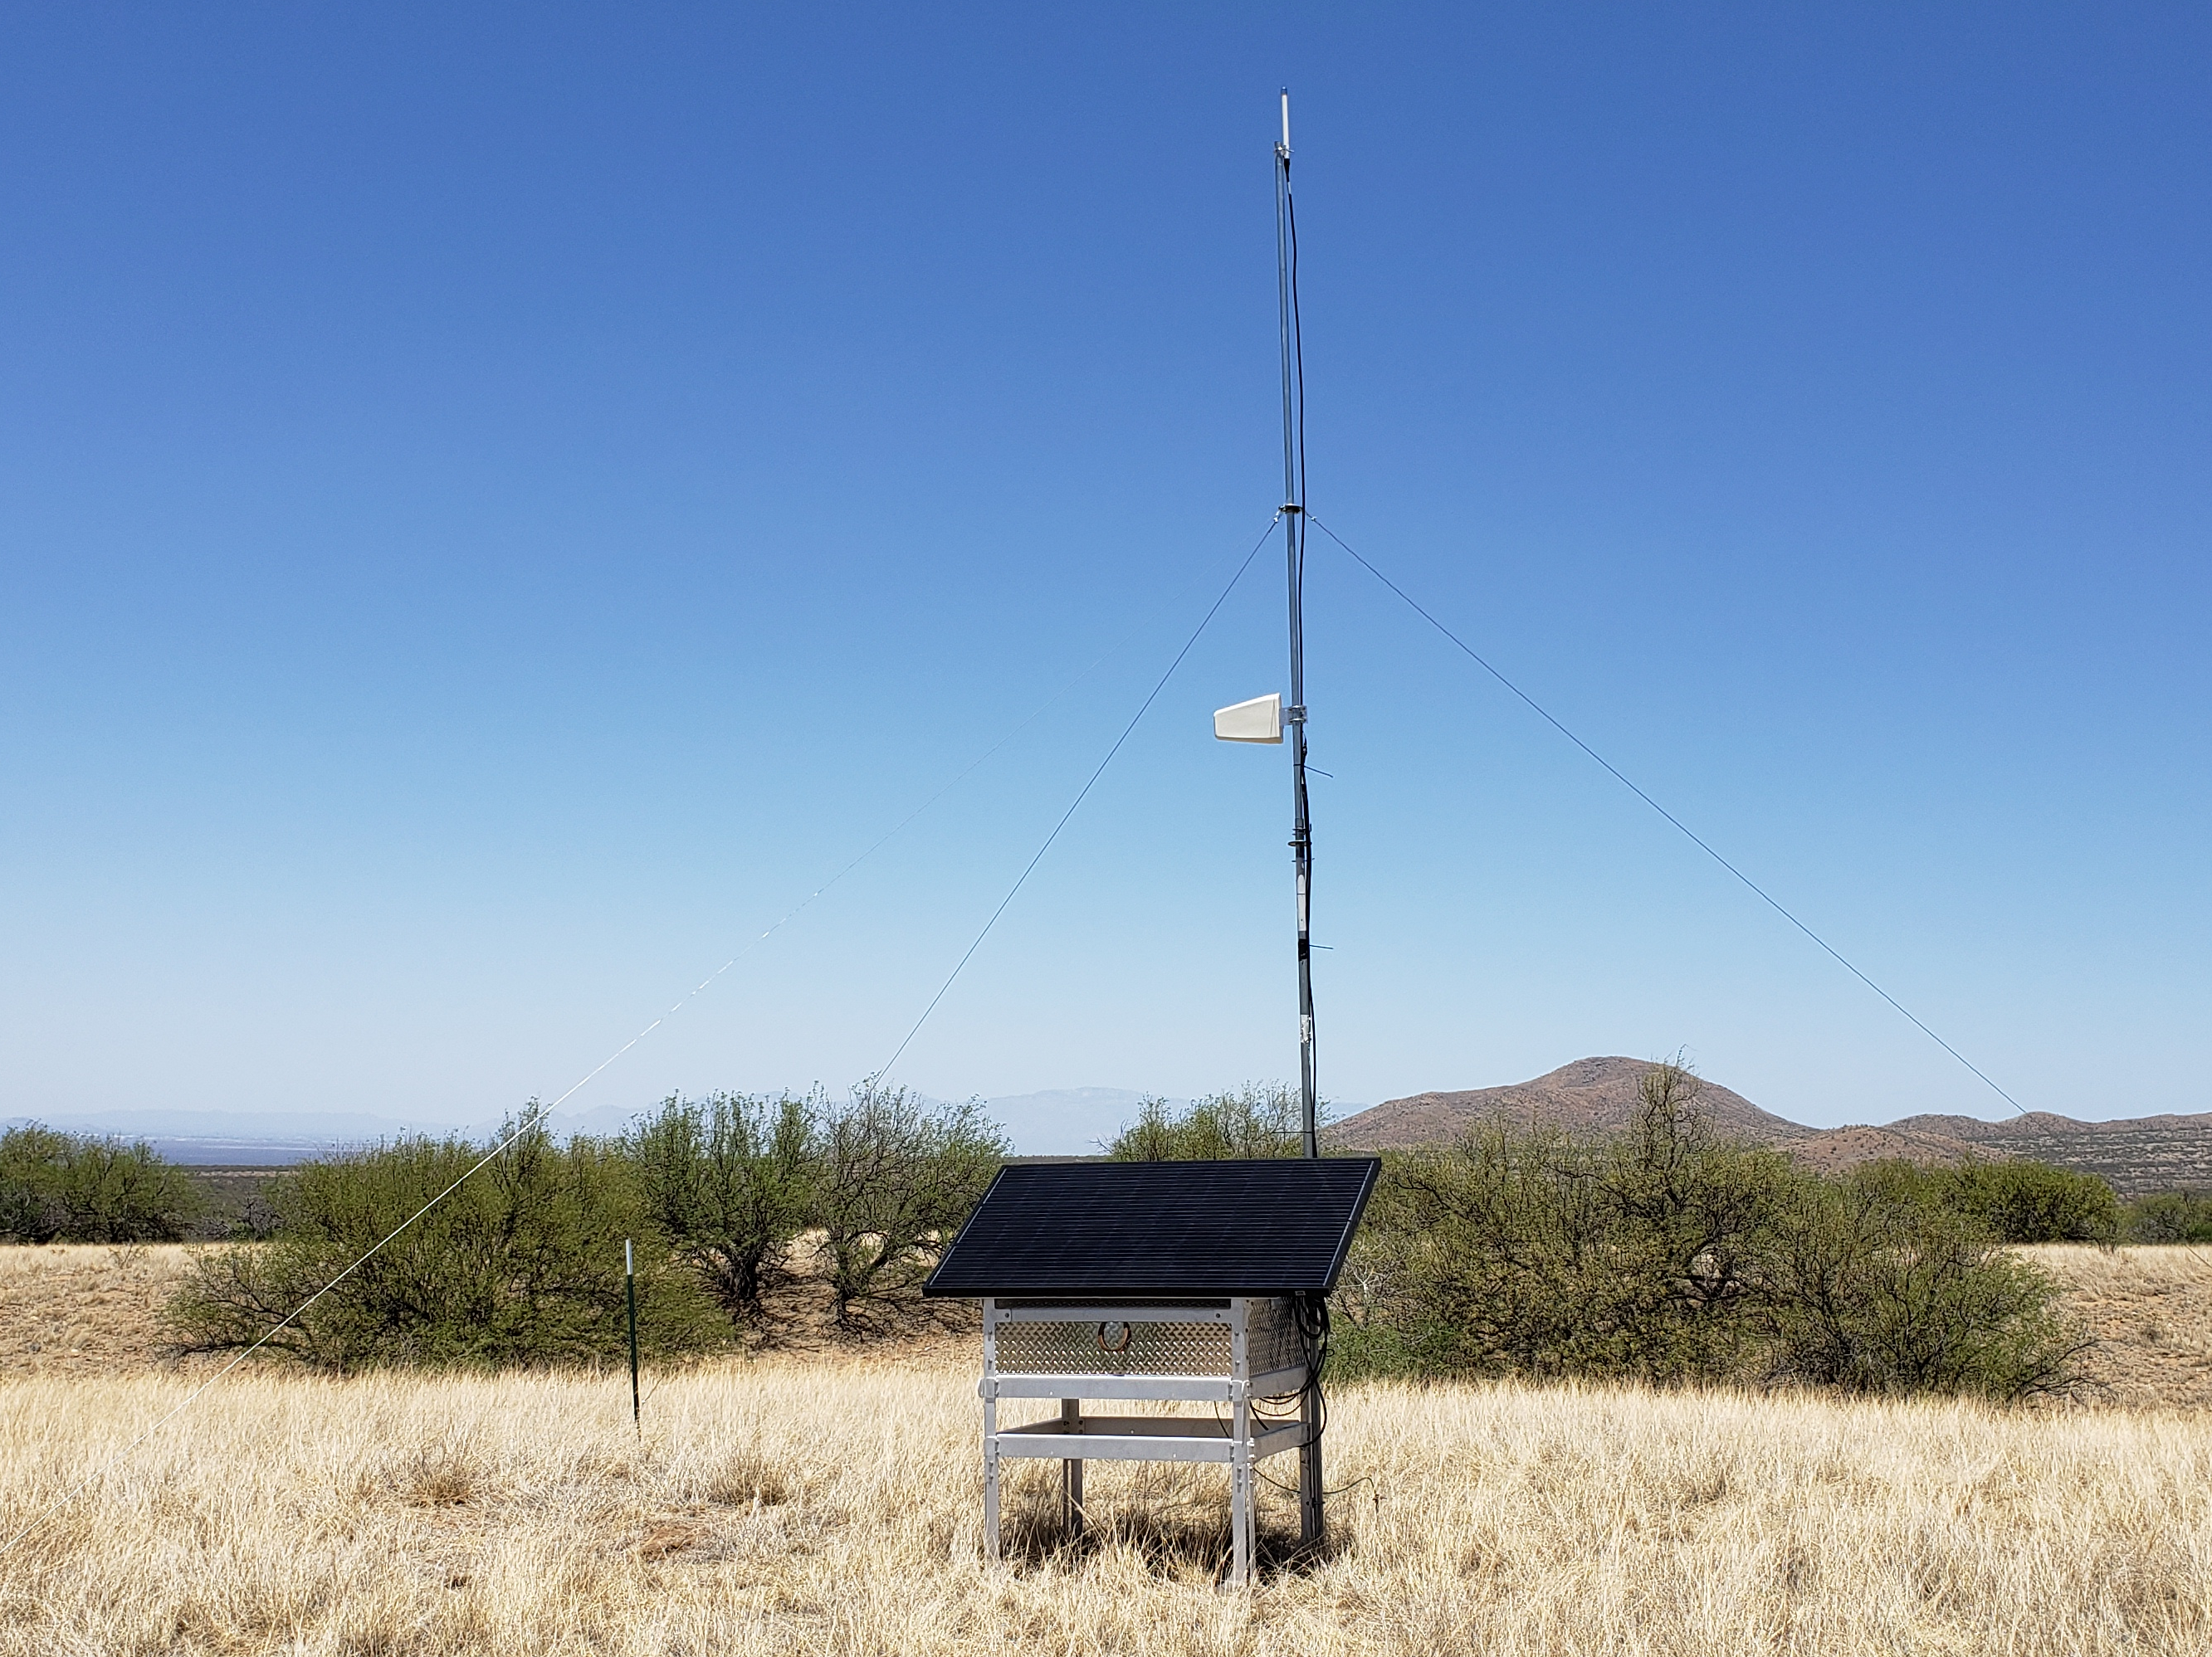
Vence Radio Base Stations

Slide 6
Data Transmitted by VF Collars
Three Message Types:
Device Status (DeviceStatusIndication)
GPS Location (GpsLocationExtIndication)
Virtual Fence Interaction (ShockEventExtIndication)

Slide 7
Accessing VF Data
Application Programming Interface (API) to access data from Vence Corp serves
Open Source and Freely Available
Request data and receive data in CSV format
As recent as the previous day’s data

Slide 8
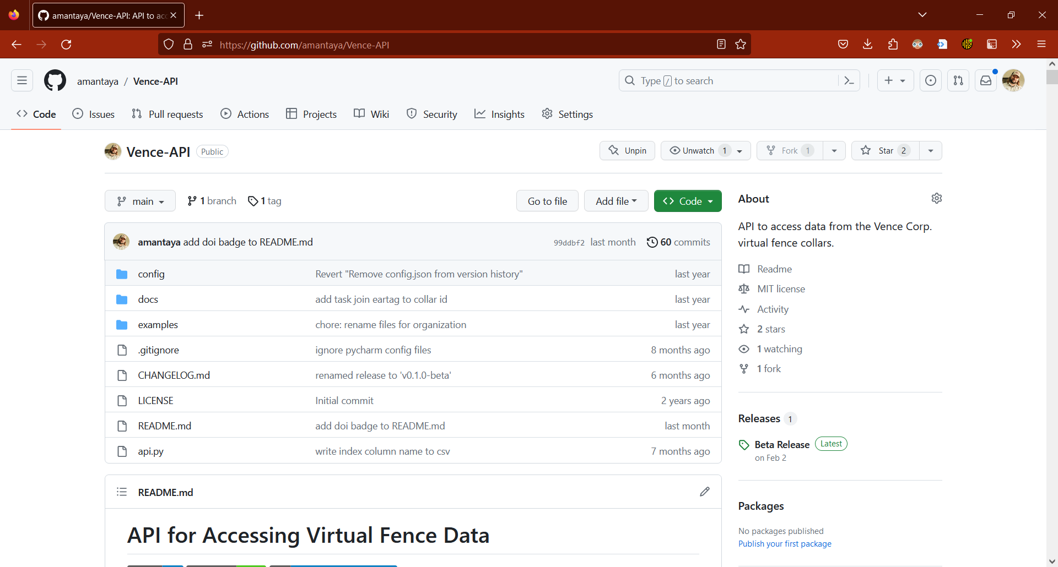
https://github.com/amantaya/Vence-API

Slide 9
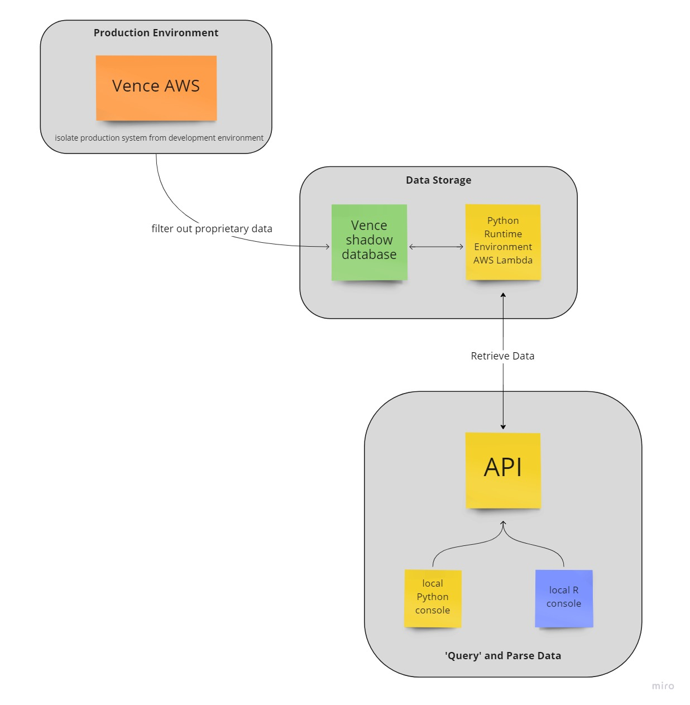

Slide 10

Funding Acknowledgement
This work is supported by the Agricultural Genome to Phenome Initiative AG2PI (USDA-NIFA award 2021-70412-35233).

Slide 11






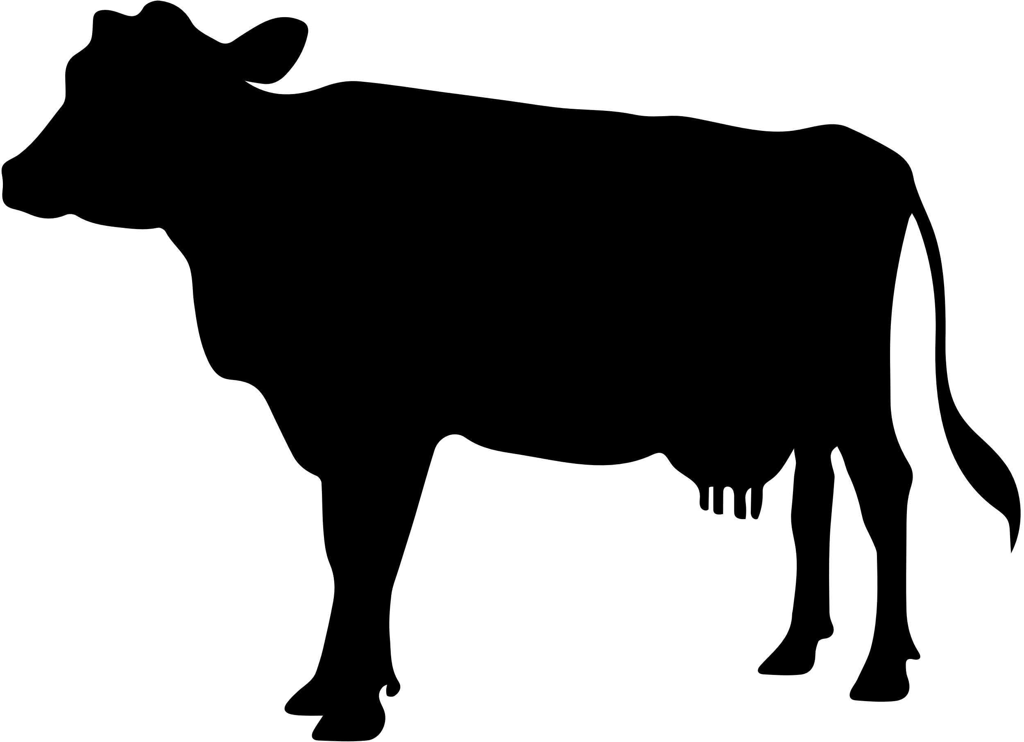
Additional Support From
Supported by
This material is based upon work that is supported by the National Institute of Food and Agriculture, U.S. Department of Agriculture, under award number 2021-38640-34695 through the Western Sustainable Agriculture Research and Education program under project number WPDP22-016. USDA is an equal opportunity employer and service provider. Any opinions, findings, conclusions, or recommendations expressed in this publication are those of the author(s) and do not necessarily reflect the view of the U.S. Department of Agriculture.
This work is supported by the AFRI Foundational and Applied Science Program: Inter- Disciplinary Engagement in Animal Systems (IDEAS) [award no. 2022-10726] from the USDA National Institute of Food and Agriculture.
Contributors
Andrew Antaya
Joslyn Beard
Carter Blouin
Brett Blum
Amber Dalke
Aaron Lien
Brandon Mayer
Sarah Noelle
George Ruyle
Additional funding was provided by Arizona Experiment Station, the Marley Endowment for Sustainable Rangeland Stewardship, and Arizona Cooperative Extension.
rangelandsgateway.org/virtual-fence

